Slide 1
Closed Economy Wealth Redistribution
Riley Latham

Slide 2
Background and Motivation
Economics major interested in labor and game theory applications
Wealth inequality
Growing in countries all over the world
Subsets of populations experience wealth distributions differently: allows us to use closed economies in our model
Using ABM’s let us find and visualize different equilibrium and solutions
People follow a rough set of rules and our agents can model this behavior

Slide 3
Intro to Economics
People buy goods and earn wages from capitalists
Overtime this changes the wealth distribution of our economy
Urban economics tell us that cities will be created if resources allow it
This means capitalists near the ‘center’ of our city should have more money than those on the outskirts
It also suggests that non-capitalists should have less money near the center of the city
Labor and public economics suggest different solutions to wealth inequalities
Universal Basic Income
Taxes and Stipends

Slide 4
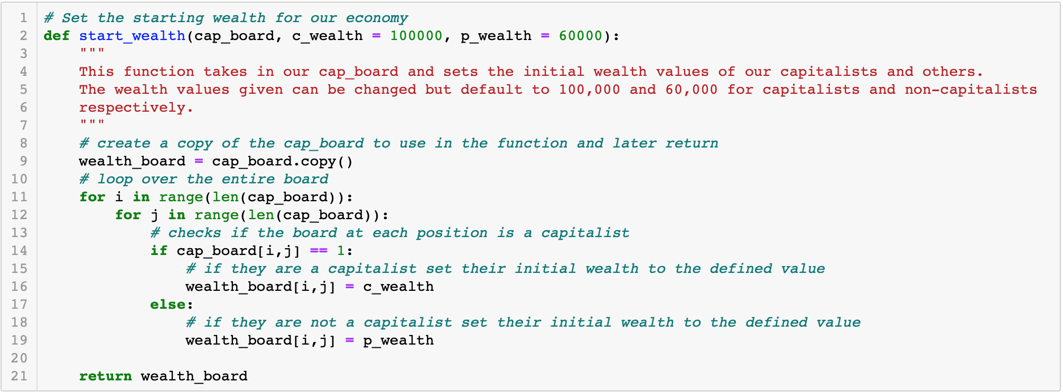
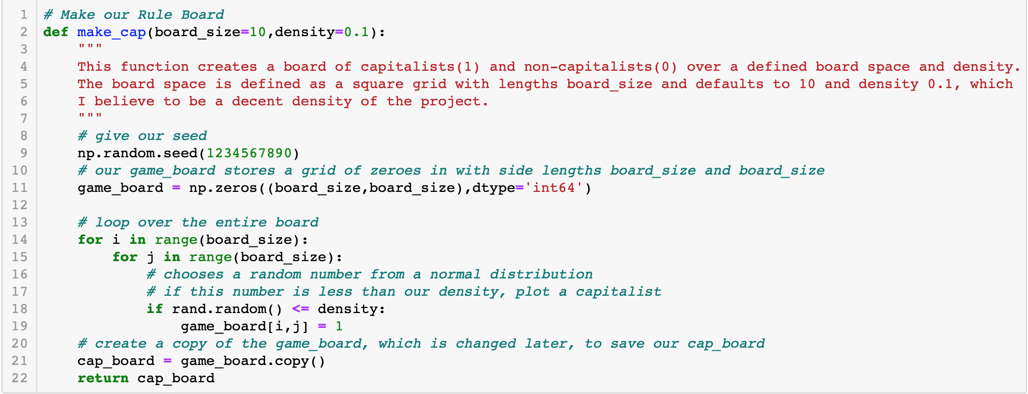
Code Structure: set up
We create two boards
A capitalist board defining capitalists with a 1 and non-capitalists with a 0
A wealth board to store and update wealth data

Slide 5
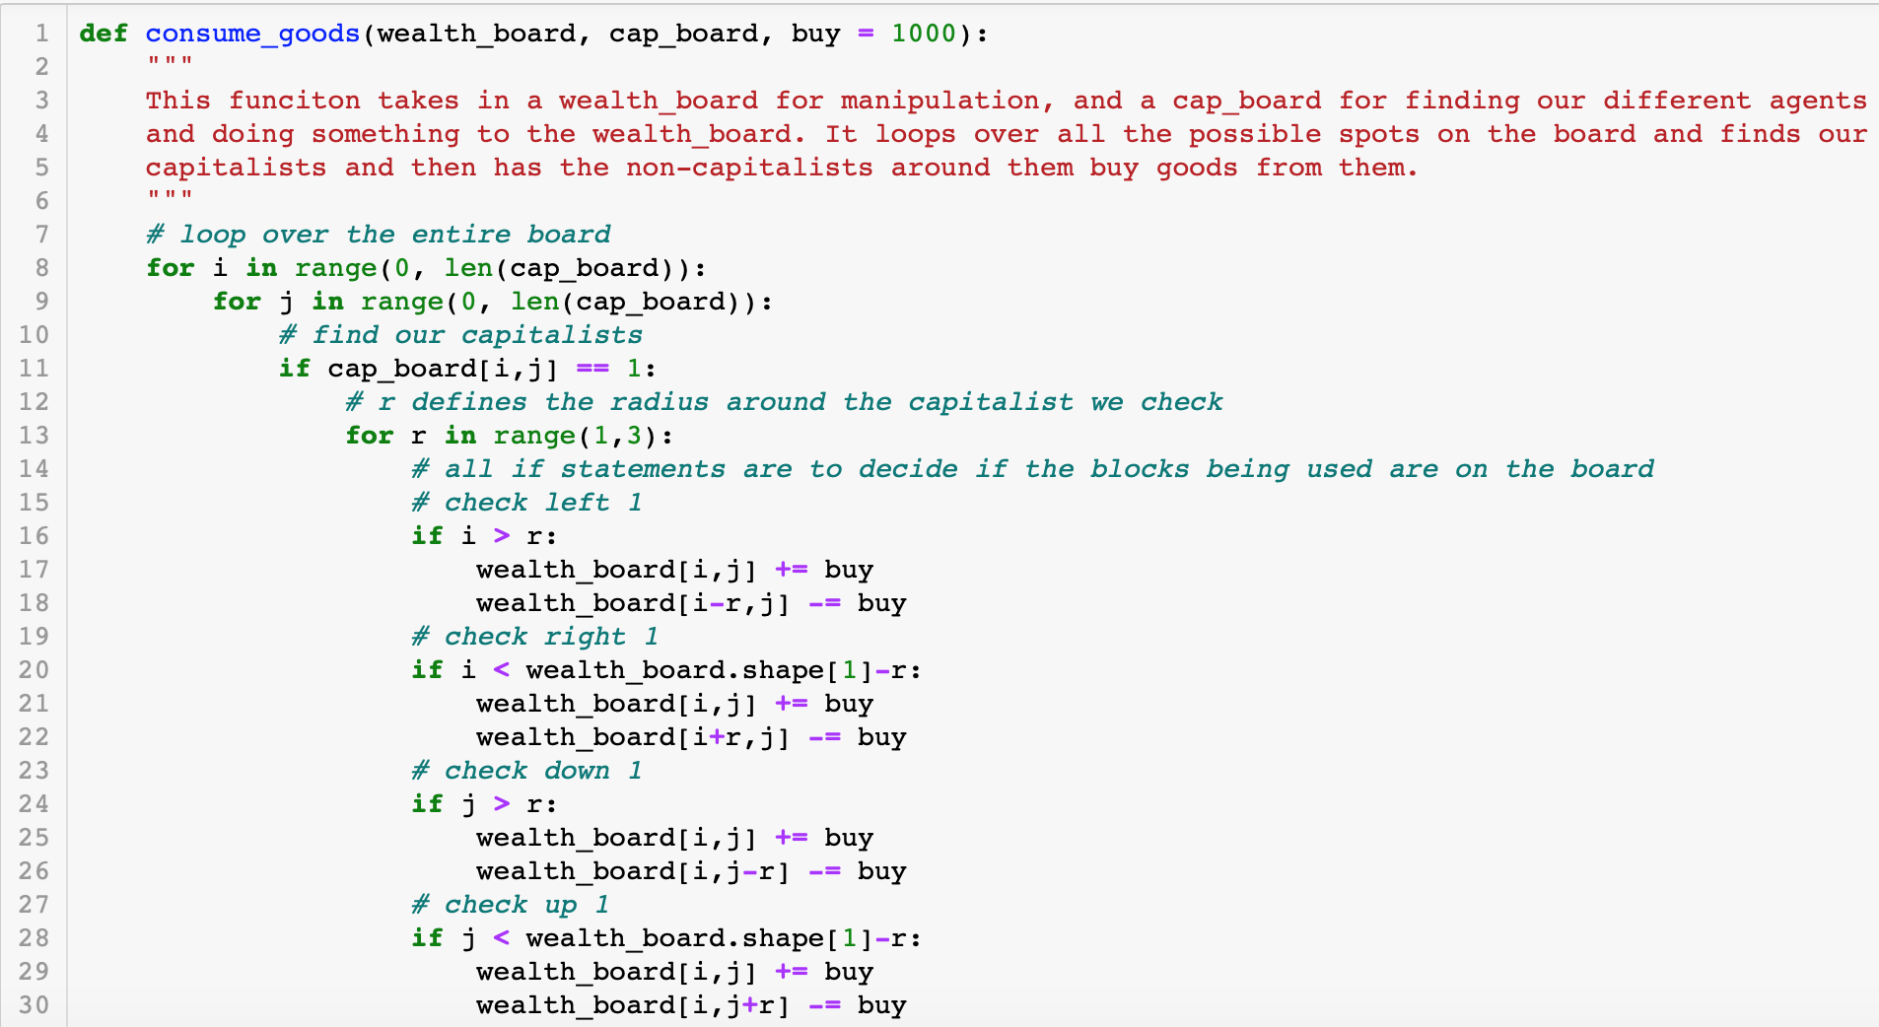
Code Structure: basic economy
Setting up the basics of a closed economy comes from the consumption and wage paying functions

Slide 6
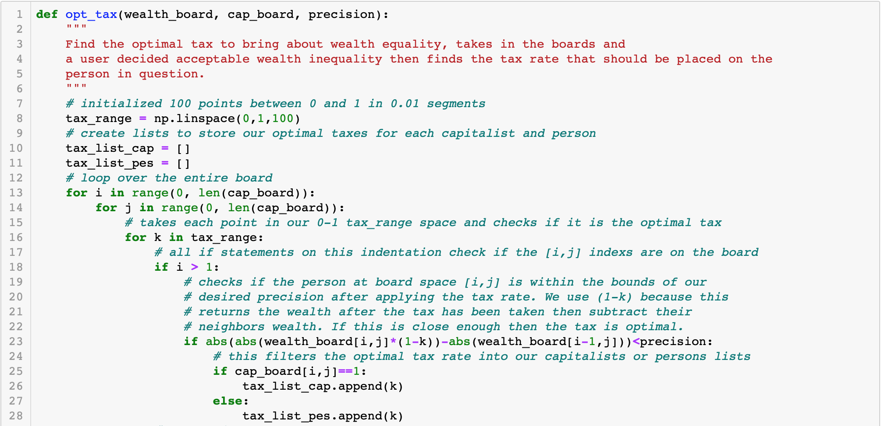
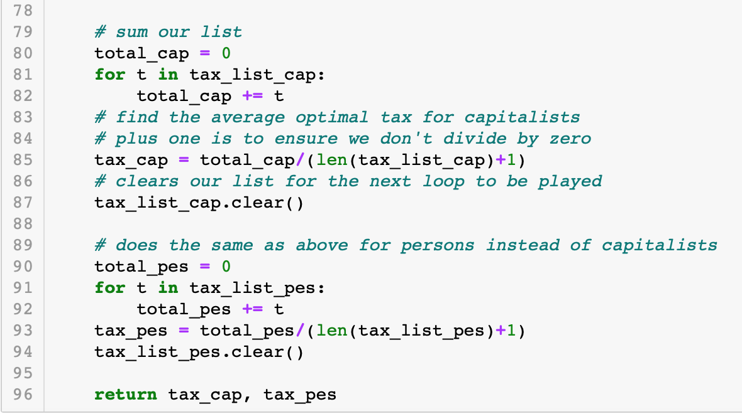
Code Structure: tax and redistribution

Slide 7
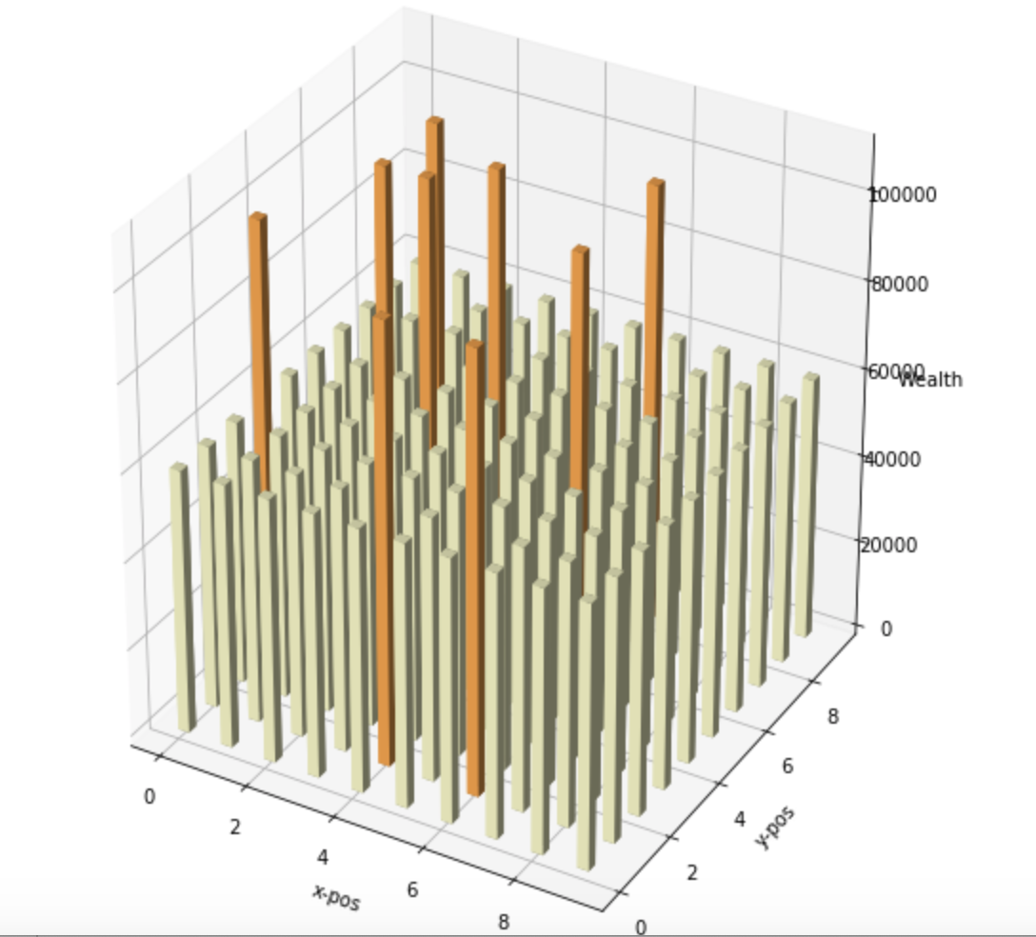
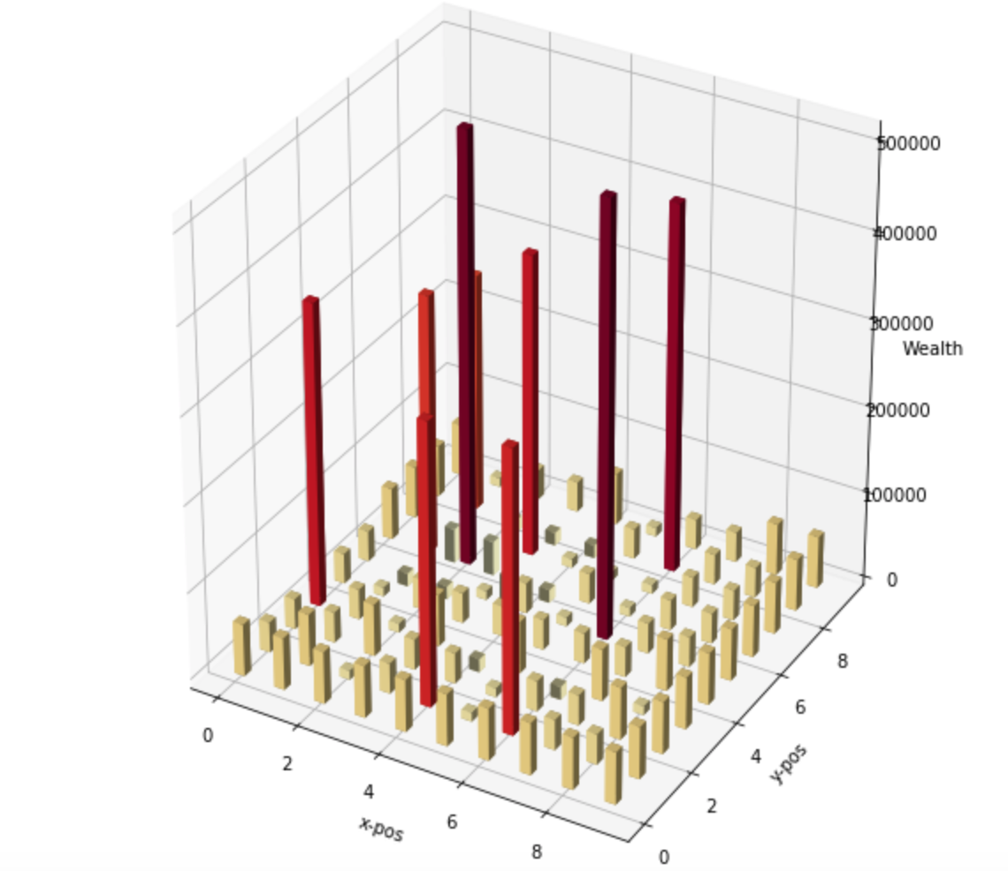
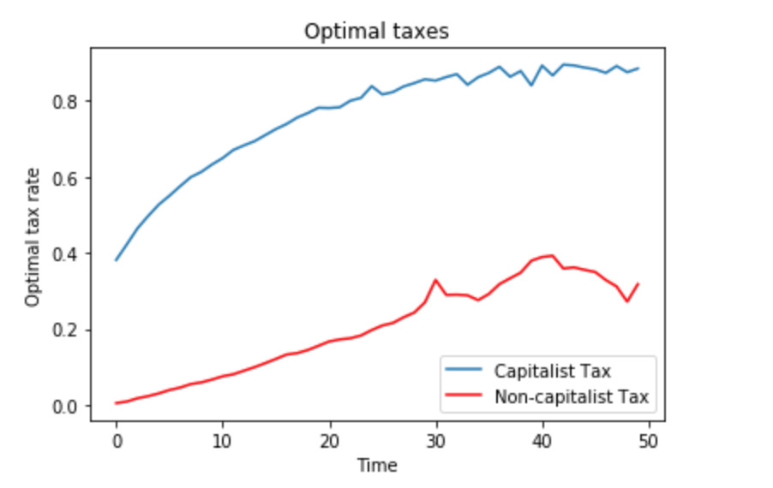
Results: Basic Economy
Economy at time 0
Economy at time 50
Optimal tax over time

Slide 8
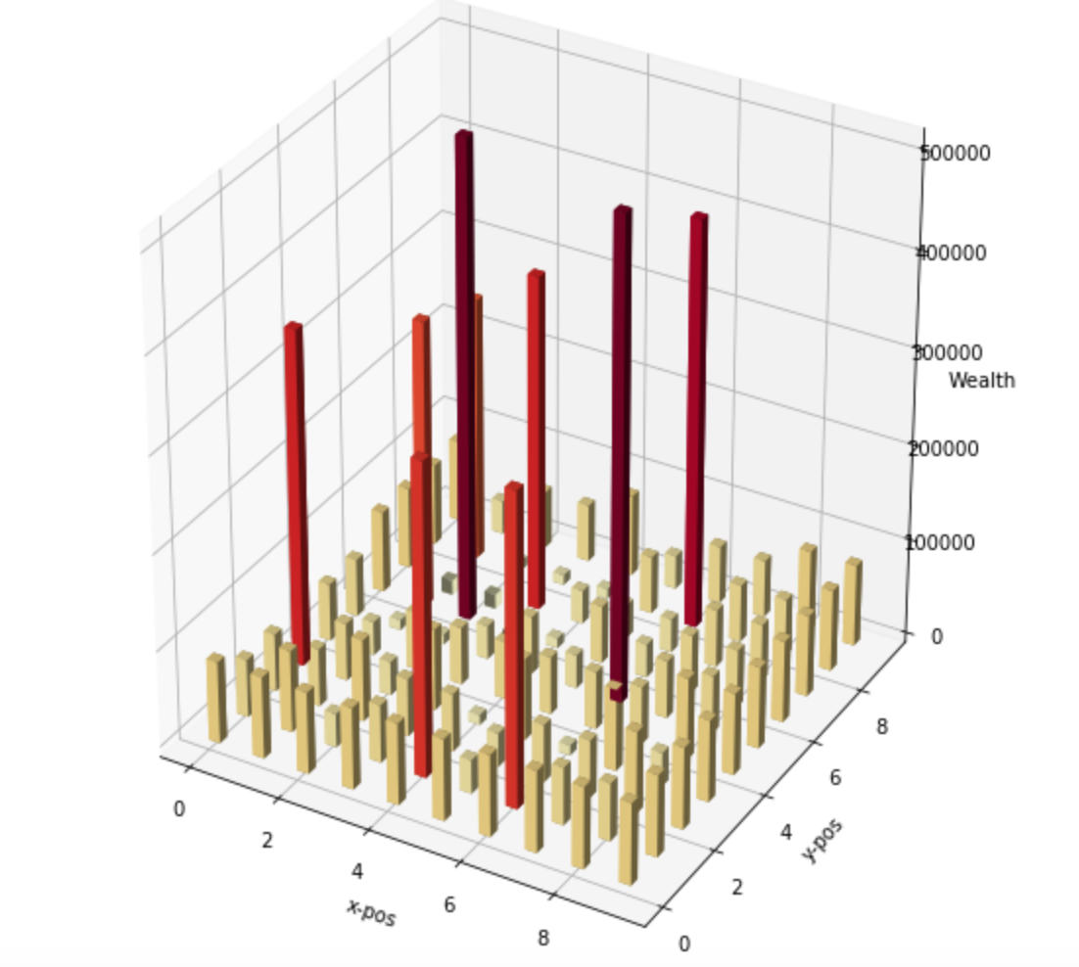
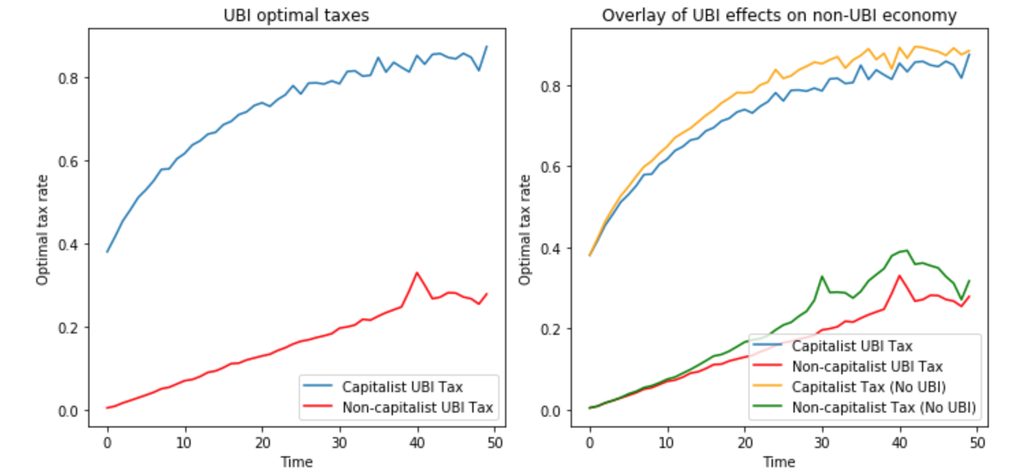
Results: UBI
Economy at time 0
Economy at time 50
Optimal tax over time

Slide 9
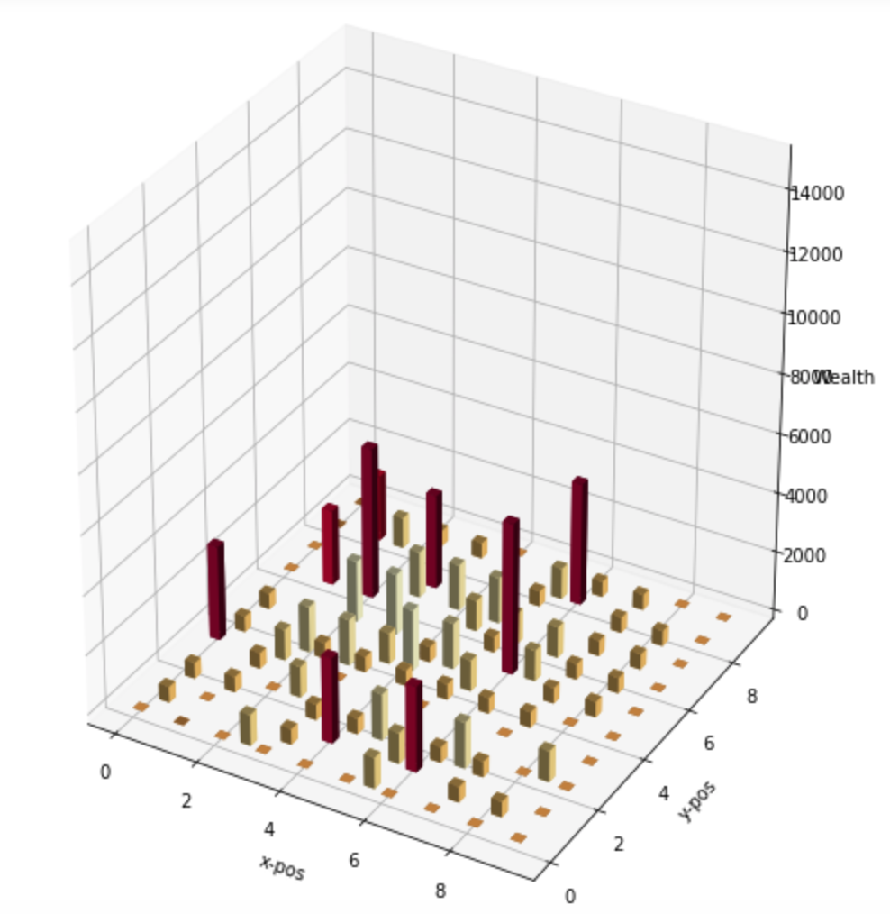
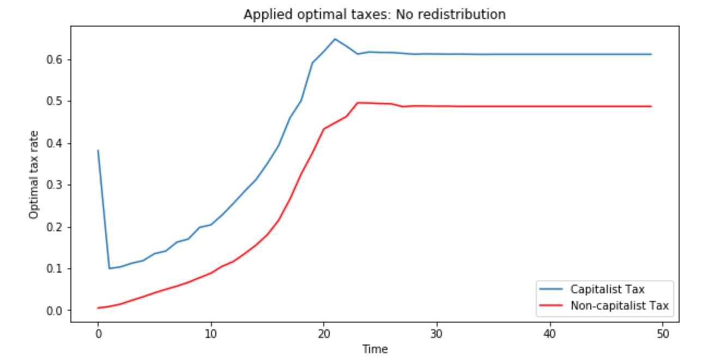
Results: Tax with No Redistribution
Economy at time 0
Economy at time 50
Optimal tax over time

Slide 10
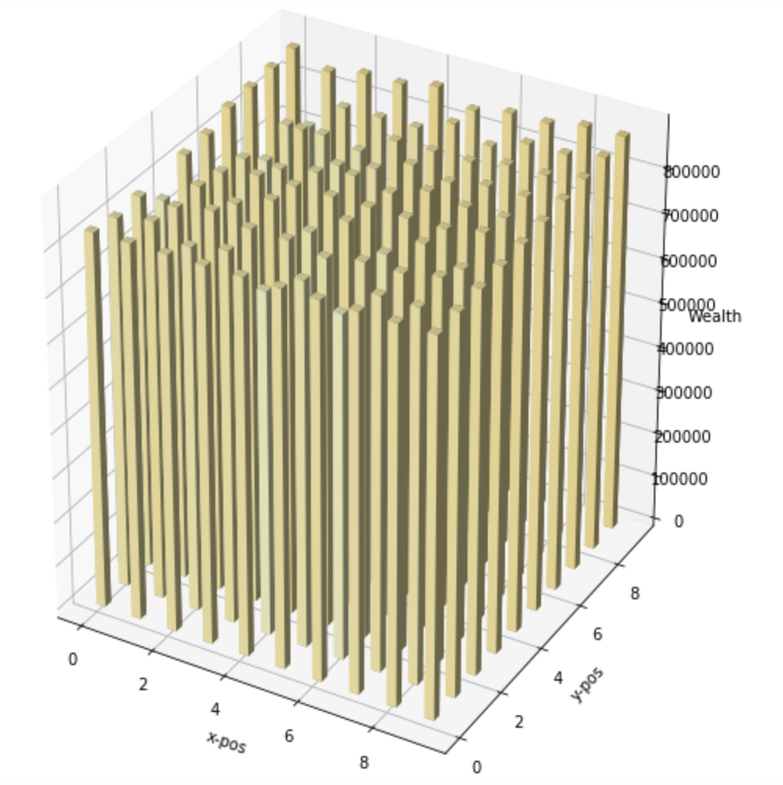
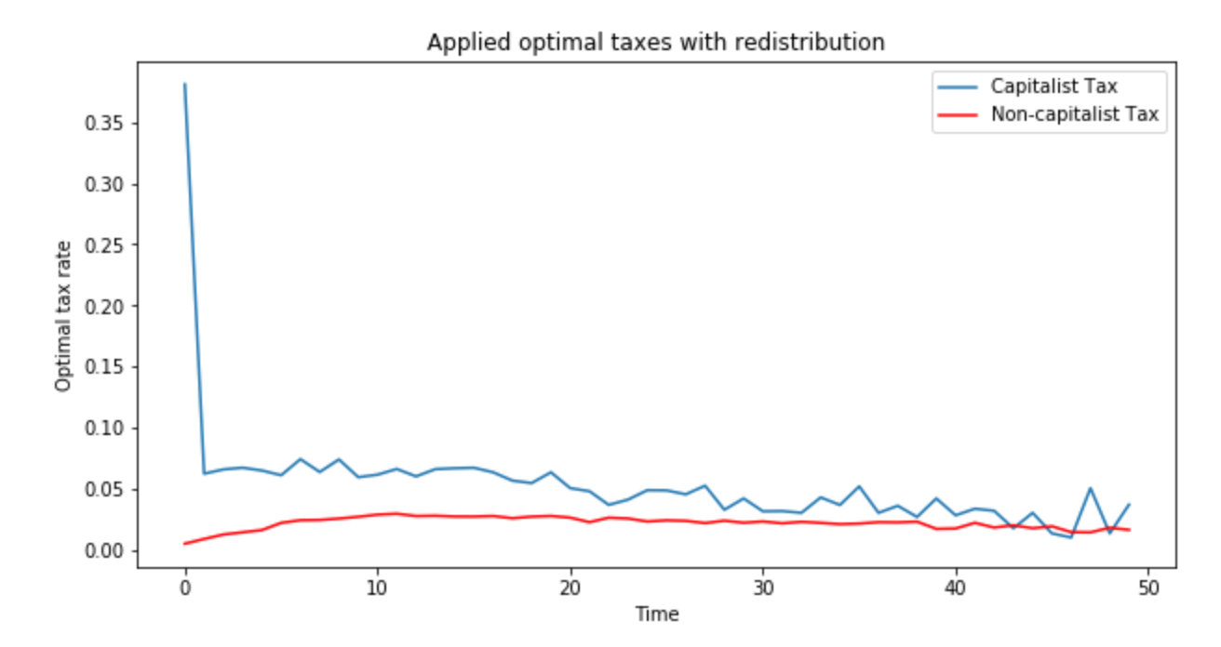
Results: Optimal Tax and Redistribution
Economy at time 0
Economy at time 50
Optimal tax over time

Slide 11
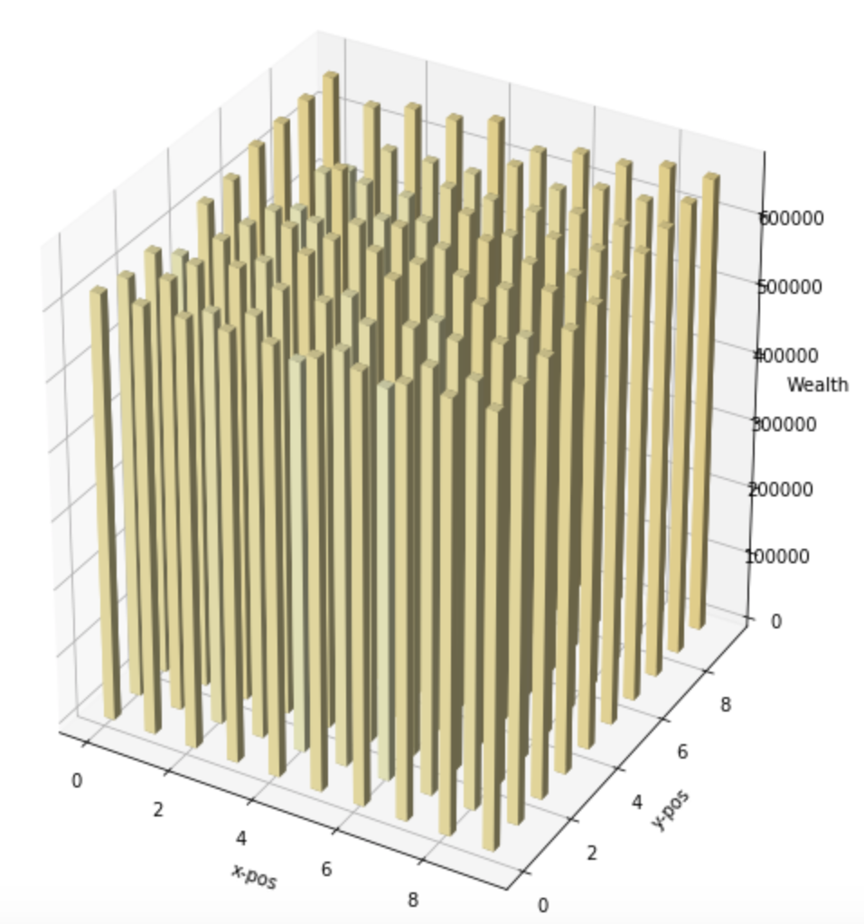
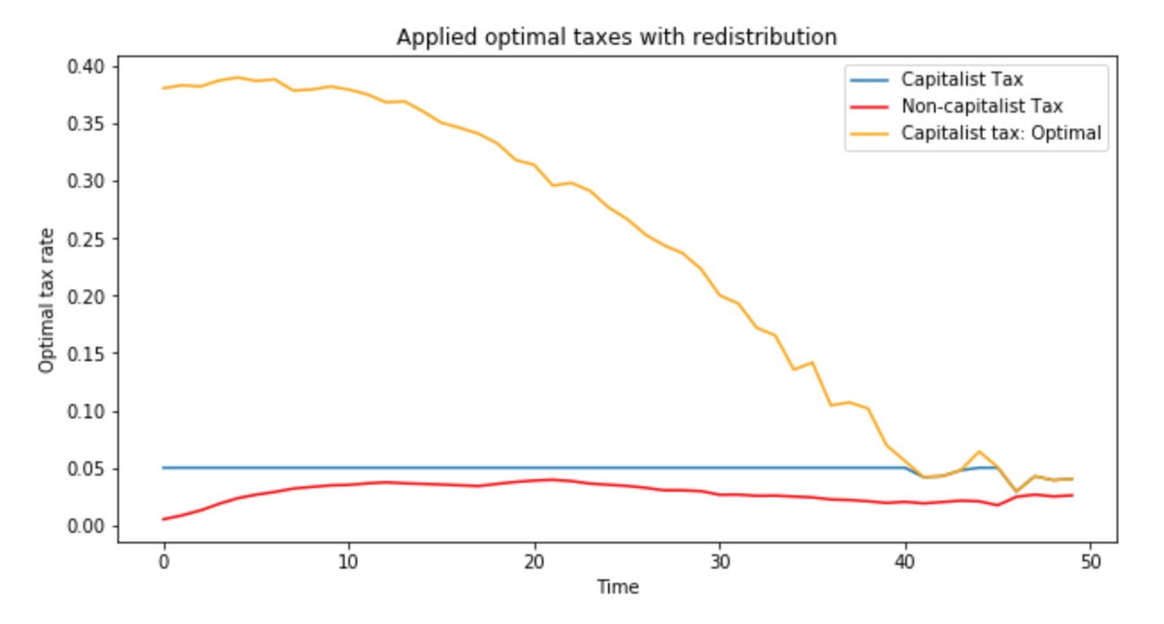
Results: Implementable Tax and Redistribution
Economy at time 0
Economy at time 50
Optimal tax over time

Slide 12
Conclusion
There is a theoretic optimal tax with a convergence across social groups
It’s also shown that it can be implemented
The model came with many challenges mainly involving creating the optimal tax function
Further improvement can be made to find more optimal taxes allowing for higher precision
Expanding the model to include trade and dynamic buying and wage functions would be a more accurate model of an economy

